Slide 1

Bitcoin Price Analysis and Forecasting
Submitted To
Submitted By
Mr. Zubeaeerul Islam
Adjunct Faculty
East Delta University
GROUP-5
243000561 – Md Fahim Shahriar Chowdhury
243000661 – Subrata Das 243000661
243001461 – Mafia Rahman Tule
243002461 – Mohammad Helal Uddin
243002561 – Wasim Kabir

Slide 2




Project Overview
Objective
Dataset
Methods
Goal
Analyze and forecast Bitcoin prices using multiple modeling approaches
Monthly Bitcoin prices from 2015 to 2023
Linear, Quadratic, and AR IMA modeling techniques
Determine the most effective forecasting approach for Bitcoin prices
This project aims to provide a comprehensive analysis of Bitcoin price forecasting using various modeling techniques, with the goal of identifying the most reliable and accurate approach.

Slide 3
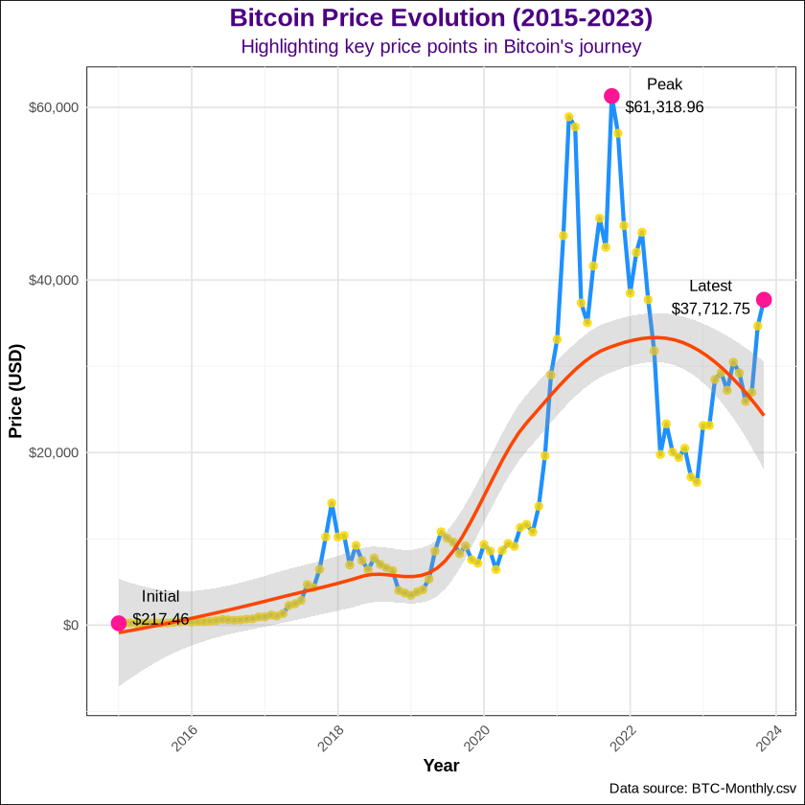
Descriptive Analysis Findings
Dramatic Growth: Bitcoin's price surged from $217.46 (Jan 2015) to $37,712.75 (Nov 2023), representing a remarkable ~17,300% increase over 8 years
Peak Performance: Bitcoin reached its highest point at $61,318.96, demonstrating the cryptocurrency's potential for extraordinary gains
Market Volatility: The trend line (red) shows distinct market cycles with periods of rapid growth followed by significant corrections, highlighting Bitcoin's characteristic volatility

Slide 4
Descriptive Analysis Findings (Contd..)
Overall Trend (2015-2023)
Key Growth Periods
Starting from relatively low prices (~$276) in 2015
Shows dramatic price appreciation over the years
Multiple significant bull and bear cycles visible
2016-2017: Massive growth of 634% (from $591 to $4,342)
2019-2020: Substantial growth of 67.7% (from $7,344 to $12,320)
The steepest price increases occurred in late 2017 and 2021
Pattern Analysis
Notable Features
The purple line shows the actual price movement
The red smoothed trend line indicates the overall market direction
The shaded area around the red line represents the confidence interval
Golden points highlight individual monthly price observations
High volatility throughout the period
Several major price cycles visible
The most dramatic price movements occurred in the latter years
Clear evidence of both rapid appreciation and significant corrections

Slide 5
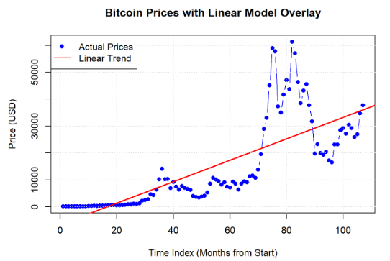
Linear Model Findings

Slide 6
Linear Model Findings (Contd..)
Trend
Model Fit
F-statistic
Intercept (-6546.91)
Time Index Coefficient (397.99)
R-squared (0.586)
Residual Standard Error (10430)
The F-statistic (148.6)
p-value (< 2.2e-16)
Strengths
Limitations
Simple to implement and interpret
Provided a basic trend line for Bitcoin price movement
Computationally efficient
Unable to capture non-linear patterns in Bitcoin price movements
Higher prediction errors due to oversimplification
Poor performance in capturing volatility

Slide 7
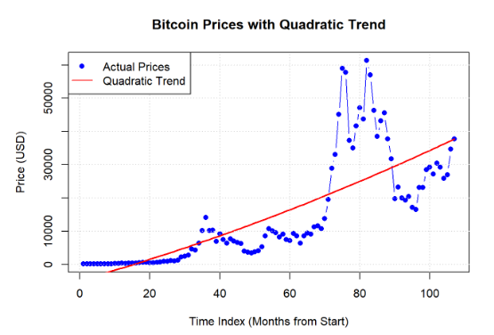
Quadratic Model Findings

Slide 8



Quadratic Model Findings (Contd..)
R-squared Value: 0.5884 (slightly better then linear model’s 0.586)
Fit Improvement over Linear Model
Still Doesn’t Capture: Price Volatility, Sudden Price Changes, Non-linear patterns
Can’t Handle: Complex market dynamics, temporal dependencies
Poor Predictive Power

Slide 9
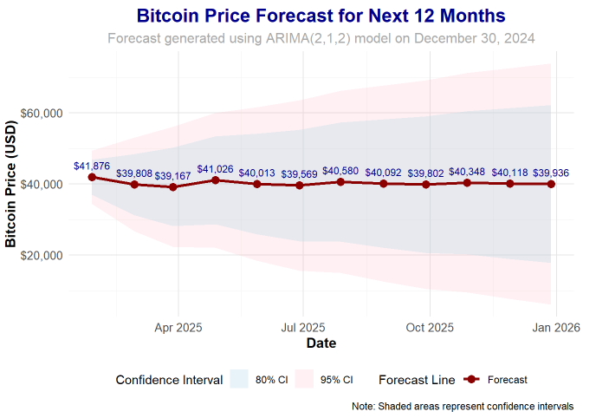
ARIMA Model Findings

Slide 10
ARIMA (2,1,2) Model Findings (Contd..)
Performance Highlights
Findings:
Lowest prediction errors
Most reliable confidence intervals
Better capture of Bitcoin price dynamics
Superior residual properties:
More symmetric distribution
Better behaved ACF/PACF plots
Smaller standard deviation in residuals
RMSE: 14648.73
MAE: 13013.09
Symmetric distribution with skewness of 0.106.
Lower Kurtosis of 8.02
AIC: 2078.834 (Lowest) and a competitive BIC score.
ADF test showing statistical significance (p < 0.05)
Limitations
Residuals show some deviation from normality
Complexity in interpretation compared to simpler models

Slide 11
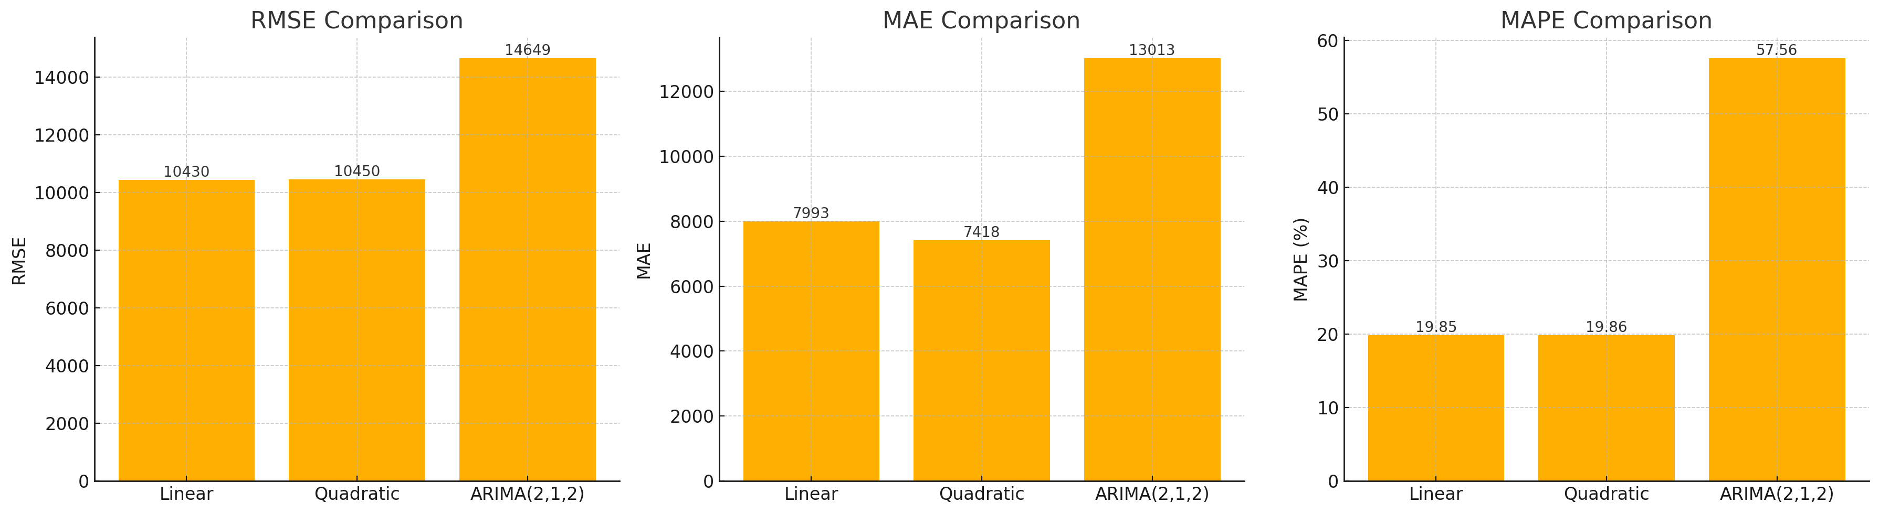
Comparative Analysis
RMSE, MAE and MAPE values for different forecasting models

Slide 12
Conclusions
ARIMA Model Provides Most Reliable Forecasts
Bitcoin Prices Show Strong Non-linear Patterns
High Volatility Requires Frequent Model Updates
The ARIMA (Autoregressive Integrated Moving Average) model outperformed the linear and quadratic regression models in forecasting Bitcoin prices. It was able to capture the complex, non-linear patterns and temporal dependencies in the price data.
The analysis revealed that Bitcoin prices exhibit strong non-linear trends and exhibit significant volatility, making them challenging to model accurately using simple linear or quadratic approaches.
Given the high volatility and dynamic nature of Bitcoin prices, the forecasting models will need to be retrained and updated regularly to maintain their predictive accuracy and reliability.
Use ARIMA for Short-term Forecasting
Consider External Factors for Comprehensive Analysis
Based on the findings, the ARIMA model is recommended for short-term forecasting of Bitcoin prices, as it demonstrated the most reliable and accurate predictions compared to the other approaches.
While the ARIMA model provided the best forecasting performance, incorporating external factors, such as macroeconomic indicators and market sentiment, could further enhance the comprehensiveness and accuracy of the analysis.

Slide 13
Thank You
Any Questions !

